Slide 1

DriverPass
System Analysis
Kyle Atkins
Notes:
No speaker notes required for this slide.

Slide 2

System Requirements
Functional: Customers and staff can reserve, change, and cancel two-hour lessons online or by phone
Functional: Each lesson is matched to a driver and a car; customers see test progress
Nonfunctional: Web-based and cloud-hosted, reachable from any computer or mobile device
Nonfunctional: Every change is recorded so you can see who did what
Notes:
Thank you for meeting with me today. I'd like to walk you through how the new DriverPass system will work and how it meets your goals. Let's start with what the system needs to do. First, customers must be able to reserve, change, and cancel two-hour driving lessons online, and your secretary must be able to do the same when someone calls or visits. The system will also match each lesson with a driver and a car so you always know who is going where. Second, it will show customers their online test progress and keep the tests up to date with notices from the DMV. Beyond what it does, we also planned for how it should perform. It will run on the web, in the cloud, so you can reach it from any computer or phone, and the cloud company will handle backups so your team can focus on running the business. It will also keep a record of every change, so you can always see who made, changed, or canceled a reservation.

Slide 3
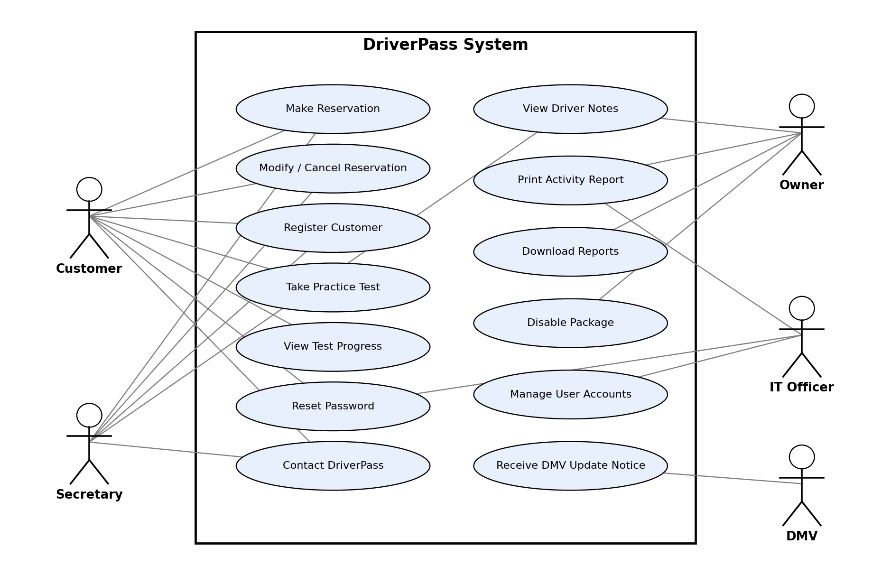
Use Case Diagram
Notes:
This picture shows who will use the system and what each person can do. Customers can sign up, book and change their lessons, take practice tests, check their progress, reset their own password, and contact you. Your secretary can do the booking and sign-up tasks for people who call or visit the office. As the owner, you can read driver notes, print the activity report, download information to work on in Excel, and turn off a package when you don't want new customers to choose it. Ian, as your IT officer, can manage accounts, such as resetting access or blocking someone who leaves the company. The DMV appears on the right because it will send you notices whenever the rules or sample questions change. Each of these pieces comes straight from what you told us you needed.

Slide 4
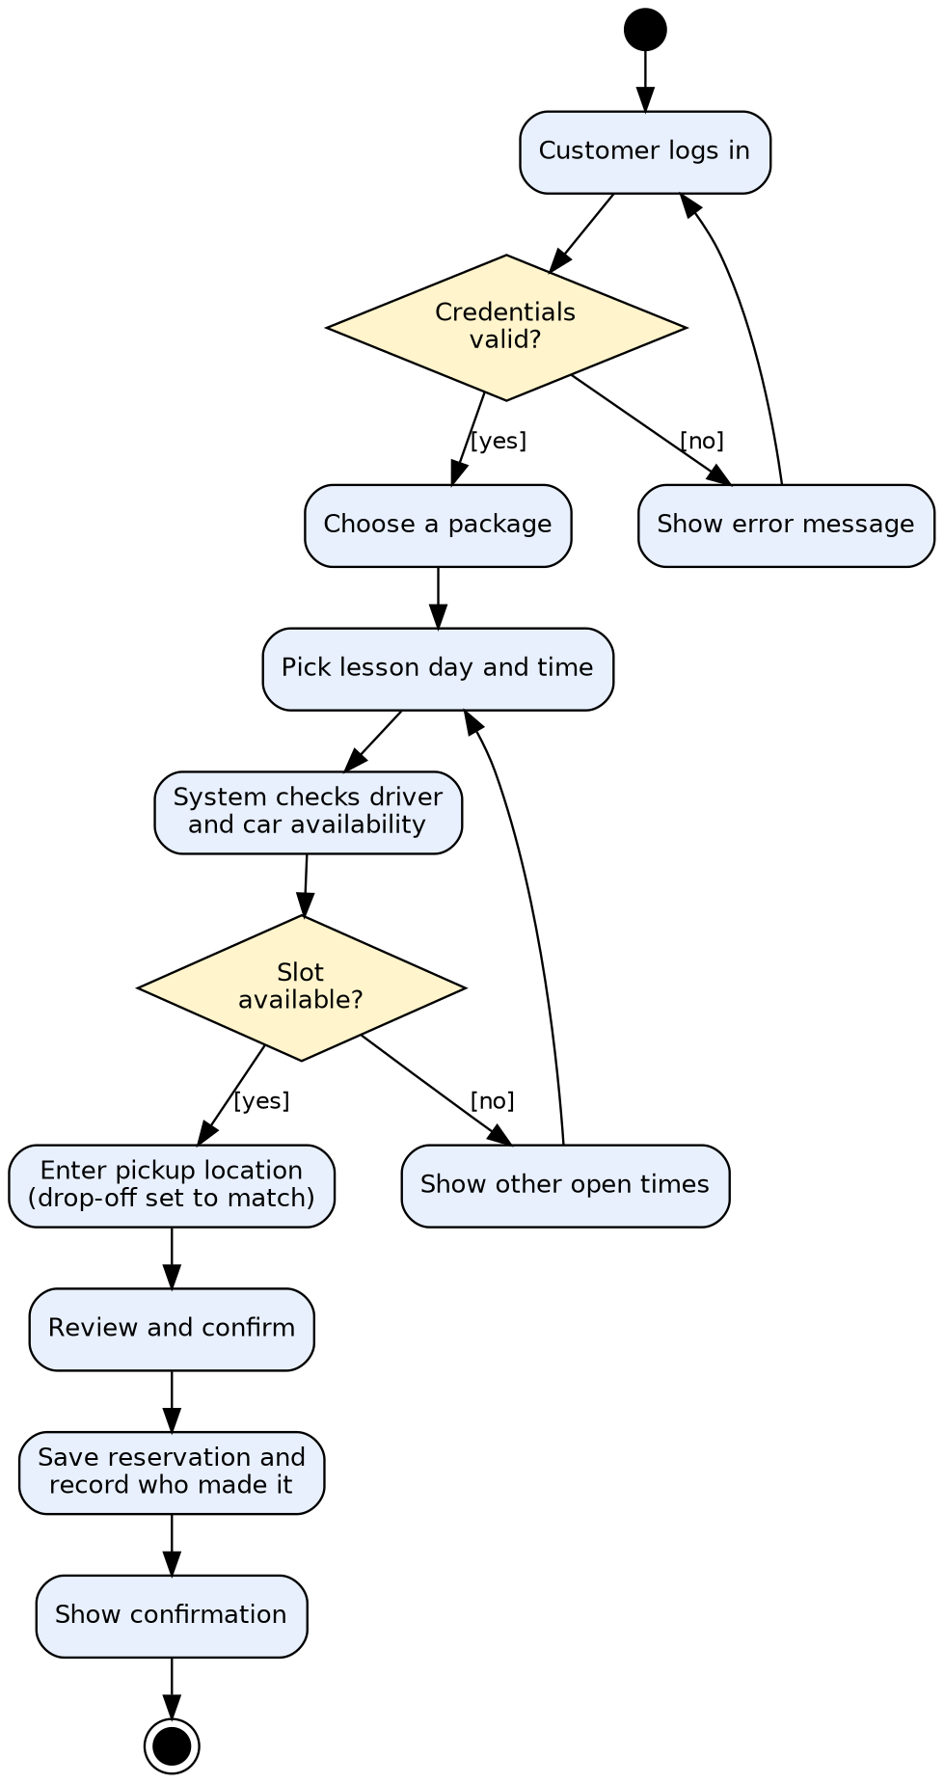
Activity
Diagram
Notes:
This slide shows the steps a customer follows to book a driving lesson online. The customer signs in, chooses one of your three packages, and picks a day and time. The system then checks that a driver and a car are free for that two-hour lesson. If nobody is free, it shows other open times so the customer can try again. If someone is free, the customer enters the pickup location, and the drop-off is set to be the same. After the customer reviews and confirms, the system saves the booking and records who made it, then shows a confirmation. This meets your needs by making online booking simple for customers, preventing double-booked drivers and cars, and giving you a clear record if something goes wrong.

Slide 5
Security
Each person sees only what their role allows
Customers can safely reset their own password
Every booking change is logged with who and when
Secure connections; backups and updates handled by the cloud provider
Card numbers kept by a trusted payment company
Notes:
Protecting your business and your customers' information was a big part of the design. Each person only sees what their job requires, so a customer can see only their own account while Ian has the access he needs to manage everyone. Customers can reset a forgotten password themselves through a link sent to their email. Every booking, change, and cancellation is recorded with the person's name and the time, which gives you the activity report you asked for. Information travels over a secure connection and is stored with protection, and the cloud company handles backups and security updates for you. Customers' card numbers are handled by a trusted payment company, so DriverPass does not keep them in your own system.

Slide 6
System Limitations
Changes require an internet connection
Offline use is limited to downloaded reports
Adding new package types needs a developer
Relies on timely updates from the DMV
Covers only the features requested for this first release
Notes:
No system does everything, so I want to be upfront about the limits of this first version. You will need an internet connection to make changes, which prevents two people from creating conflicting records; offline, you can look at reports you've already downloaded. The three packages are built in, and you will be able to turn a package off, but adding or reshaping packages will need a developer for now. The system depends on the DMV's updates arriving on time, and someone will still need to review them. Finally, this design covers the features you described, and ideas such as new services can be considered in a later release once you have used the system.

